Slide 1
Hybrid EAR + CNN Driver Drowsiness Detection
Final Project Presentation

Slide 2
Introduction
Drowsiness is one of the most dangerous states for a driver, often occurring without warning. The most reliable physiological cue for detecting drowsiness is eye behavior—specifically prolonged eyelid closure and reduced blinking frequency.
Our project builds a real-time hybrid drowsiness detection system combining:
Eye Aspect Ratio (EAR) from facial landmarks
CNN-based eye classification
Designed to work under real-world driving conditions (glasses, low-light, occlusion).It outputs real-time alerts, analytics, and automatic session reports.

Slide 3
Problem Statement & Motivation
Existing approaches for drowsiness detection fall short in real-world scenarios. Geometric methods are lightweight but fragile.
CNN-only methods are more robust to lighting but struggle when the eye is partially blocked.
Traditional drowsiness detection systems often rely on single-modality signals, Thus fails with :
Poor or lost facial landmarks.
Low or uneven lighting.
Eye is too small, blurry, or fully occluded.
Light reflections change appearance.

Slide 4
Problem Statement & Motivation contd.
To solve these limitations, we built a hybrid multi-modal driver alertness monitoring system combining:
Geometric features (EAR)
Deep-learning visual features (MobileNetV2 CNN)
Auto-calibrated personalized thresholds
Sliding window temporal modeling
Fallback handling under glare/occlusion
This hybridization significantly improves robustness across glasses, low light, partial occlusions, and side-angle views.

Slide 5
Dataset Overview
Dataset Used:
MRL Eye Dataset (Kaggle public dataset for eye-state classification)
https://www.kaggle.com/datasets/tauilabdelilah/mrl-eye-dataset
Total Samples Used:
81,675 training images
3,223 validation images
Class Labels:
Open (various angles & lighting)
Closed (full closure & partial closure)
Image Types Included:
Visible Light (RGB)
Infrared (IR)
With Glasses / Without Glasses
Left Eye / Right Eye
Strengths of the Dataset:
High diversity across subjects, lighting, camera types
Robust to real-world driving scenarios
Supports training for glare, low-light, and occlusion cases
Reason for Choosing This Dataset:
Largest labeled eye-state dataset
Contains real-world variations that match drowsiness detection needs
Promotes generalization for hybrid CNN + EAR system

Slide 6
Data Preprocessing
1. Dataset Cleaning:
Loaded raw MRL Eye Dataset folders
Verified and filtered mislabeled images
Removed corrupted or unreadable samples
Balanced open/closed classes
2. Eye Crop Standardization:
Original images vary in:
Size
Resolution
Illumination
Camera type (IR vs RGB)
All images resized to 160 × 160
Converted to RGB color format
Pixel intensities normalized to [0, 1]
This ensures the MobileNetV2 model receives uniformly formatted inputs.
3. Dataset Split:
81,675 images for training
3,223 images for validation
Balanced proportions of:
Glasses vs no-glasses
IR vs visible
Open vs closed
Left vs right eye
4. Label Encoding:
Directory-based labeling:
open/ → label 1
closed/ → label 0
Automatically recognized by the Keras ImageDataGenerator

Slide 7
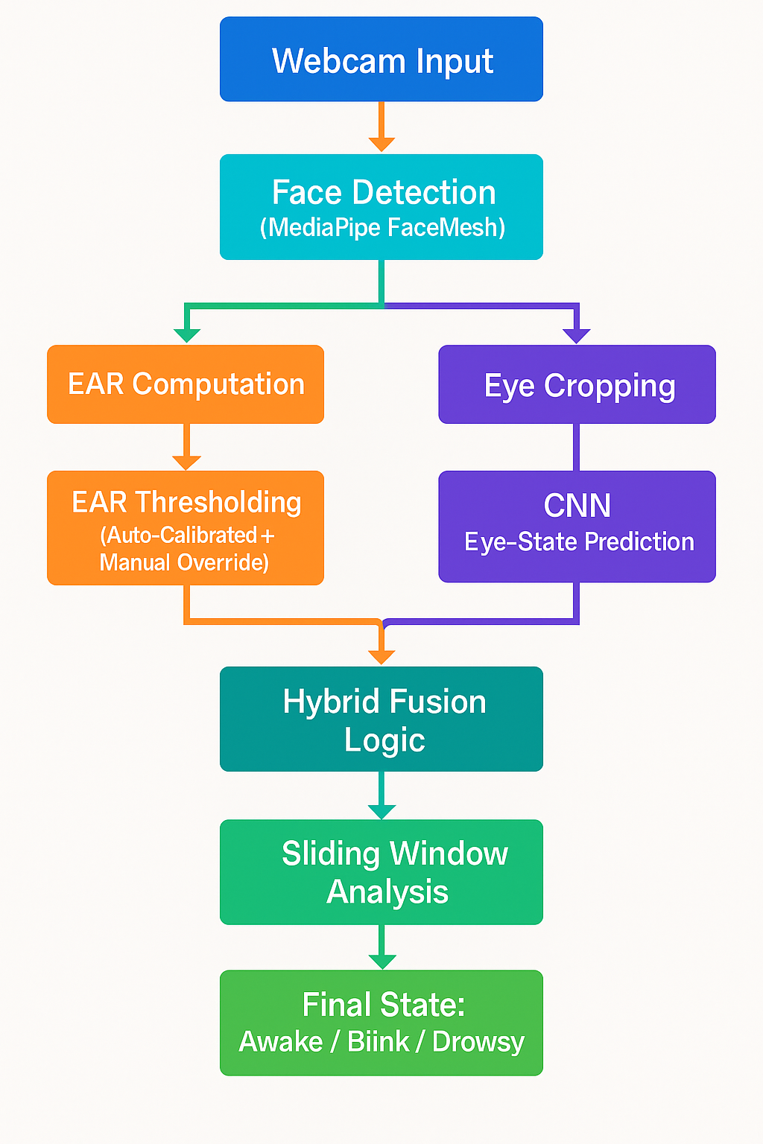
System Architecture
Our system uses a hybrid approach, combining classical CV (EAR) and Deep Learning (CNN).
Real-time pipeline runs continuously at the webcam frame rate.
The pipeline is modular, enabling independent upgrades to each component.
Pipeline Components:
Webcam Input
Captures live video frames at ~30 FPS.
MediaPipe FaceMesh
Detects face and extracts 468 facial landmarks with high speed.
EAR Module (Eye Aspect Ratio)
Computes EAR from eye landmarks (is the eye open/closing?).
CNN Model (MobileNetV2)
Takes cropped eye images and predicts Open / Closed state.
Hybrid Fusion Engine
Combines EAR + CNN outputs for more reliable prediction.
State Analyzer
Uses a sliding window to classify session state
Final State:
Awake / Blink / Drowsy.

Slide 8
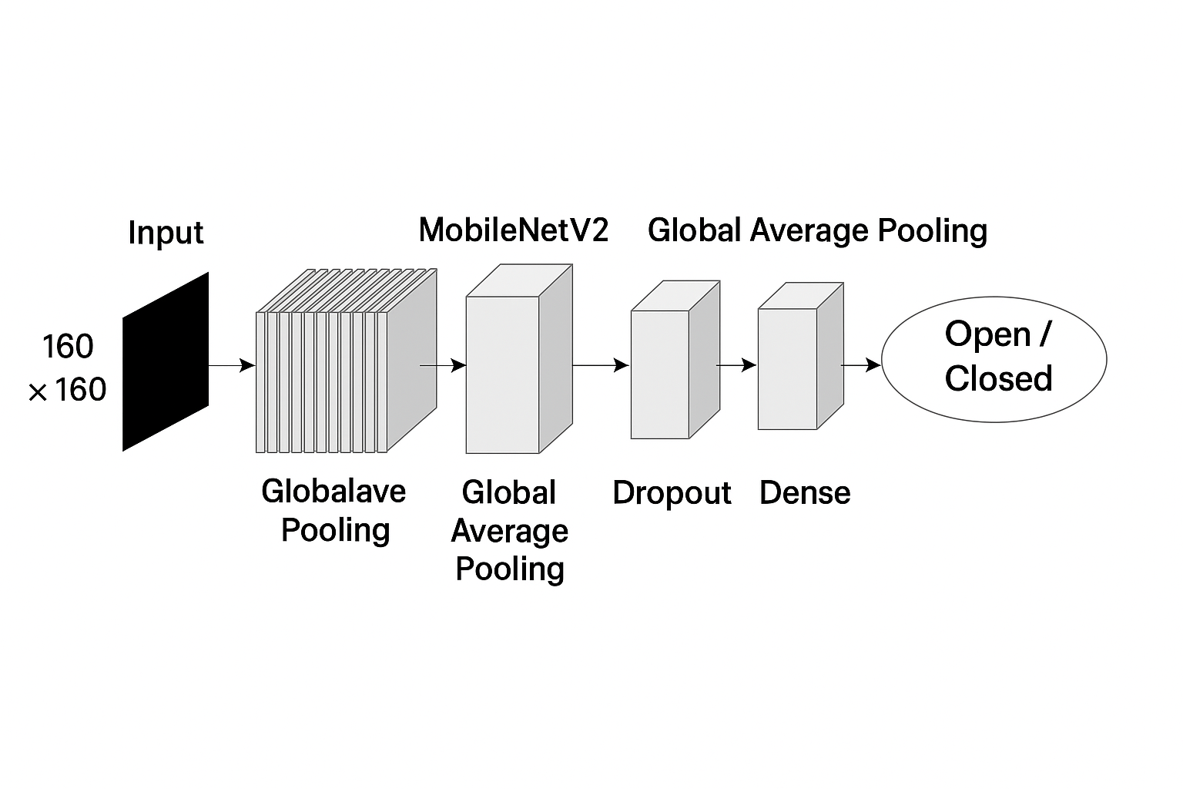
CNN Architecture for Eye-State Classification
Uses MobileNetV2 as lightweight backbone (pretrained on ImageNet)
Input: 160 × 160 × 3 eye crop (RGB)
Early layers frozen → stable feature extraction
Last 75 layers fine-tuned for eye-state domain
Feature extraction through Depthwise + Pointwise Convolutions
Global Average Pooling reduces spatial dimensions
Dropout (0.3) added to reduce overfitting
Final Dense (Sigmoid) layer → predicts Open or Closed
Optimized using Adam + Binary Cross-Entropy

Slide 9
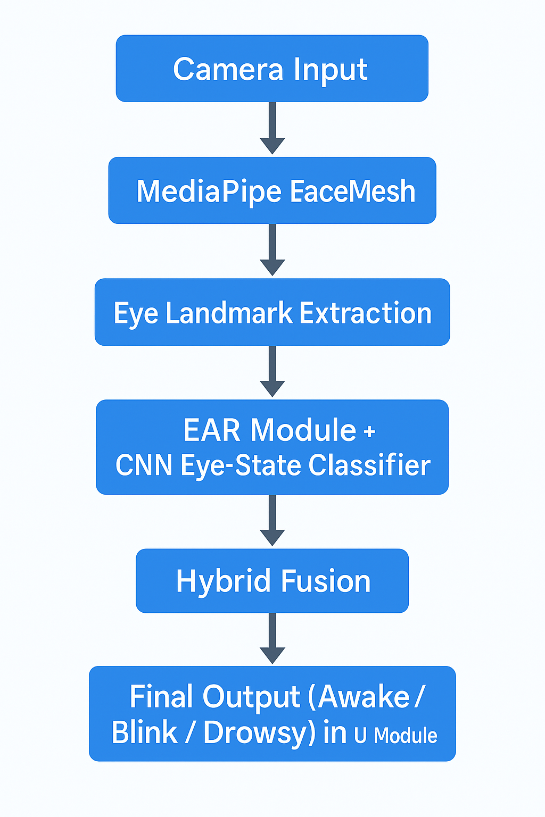
Methodology
1. Webcam Input
Live video stream captured in real time (20–30 FPS)
2. Face Detection (MediaPipe FaceMesh)
468 facial landmarks
Robust to angles, lighting, glasses
3. Eye Landmark Extraction
Specific points around left & right eye
Used for EAR + eye crop
4. Dual-Branch Processing:
A. EAR Branch (Geometric Path)
EAR computed using vertical/horizontal eye distances
EAR smoothing over 8 frames
Personalized EAR Threshold
Auto-calibrated during first 3 seconds
User override supported
EAR → Open / Closed estimate

Slide 10
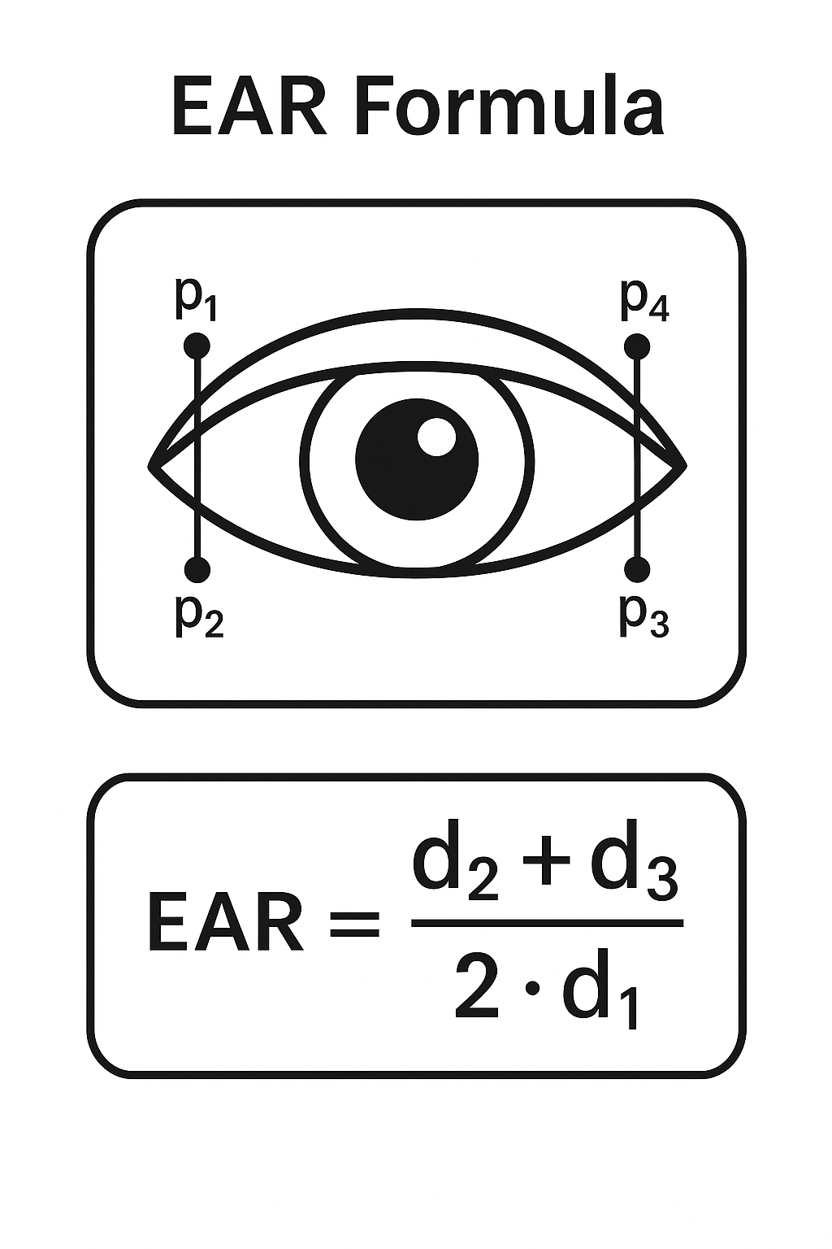
Methodology contd.
B. CNN Branch (Deep Learning Path)
Eye crops extracted from landmark coordinates
Preprocessed to 160×160
MobileNetV2 classifier outputs P(open) → P(closed)
Handles glasses, glare, low-light
Invalid crops discarded
CNN → Open / Closed estimate
5. Hybrid Fusion Logic
Combines EAR + CNN predictions
Rules:
Strong CNN-open overrides false EAR dips
Both EAR & CNN must agree for closed state
If only one eye visible → single-eye fallback
Produces stable frame-level decision:
Awake / Blink / Closed

Slide 11
Methodology contd.
6. Sliding Window Analysis
30-frame Closed/Not-Closed history
Computes Closed Ratio
Closed Ratio > 0.5 ⇒ Drowsy state
7. Final Output Layer
Determines driver condition:
Awake
Blink / Closing
Drowsy
Real-time UI overlay shows:
EAR value
CNN probabilities
Status text
8. UI Display + Session Logging
EAR-over-time plot
EAR histogram
Time distribution pie chart
Detailed statistics table
Auto-generated:
PNGs
CSV session log
PDF report

Slide 12
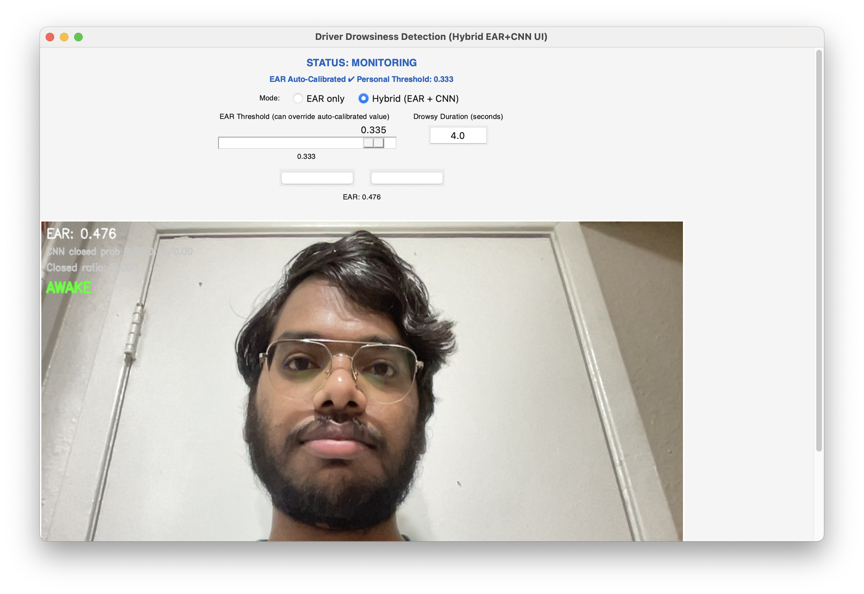
UI Overview (Hybrid EAR + CNN Application)
Top Panel
EAR threshold slider (auto-calibrated + manual override)
Drowsy duration entry (in seconds)
Current EAR display
Mode selection: EAR only / Hybrid
Start / Stop controls
Center Panel
Live video feed (900×550 resolution)
Real-time EAR value + CNN closed probability
Status overlay: AWAKE / Blink / Drowsy
Eye landmarks visualization (MediaPipe)

Slide 13
UI Overview & example tates

Slide 14
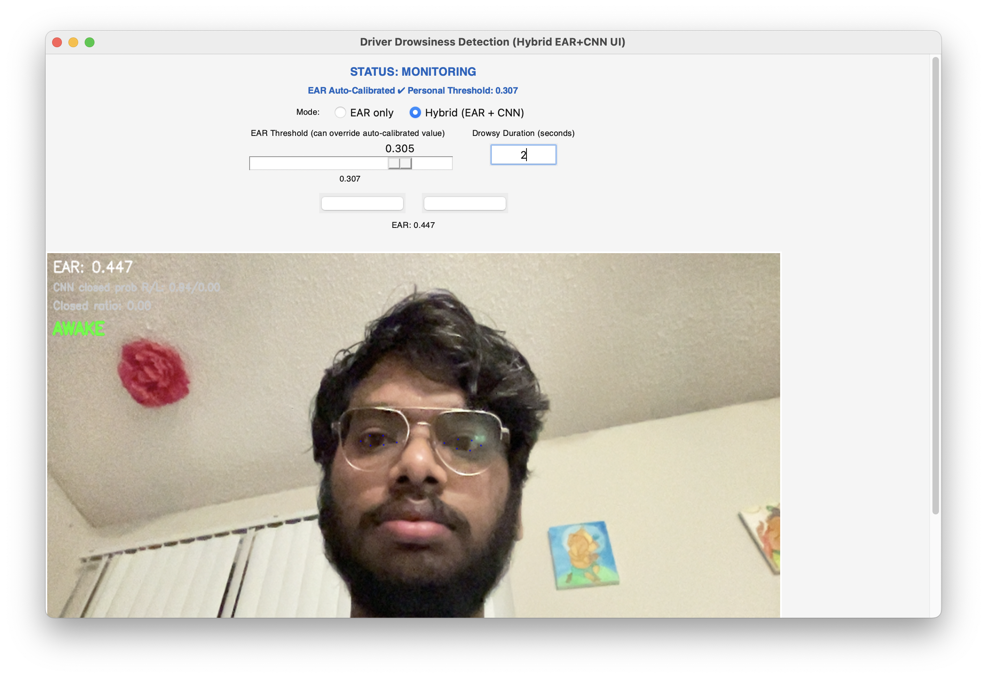
Awake Example Frame

Slide 15
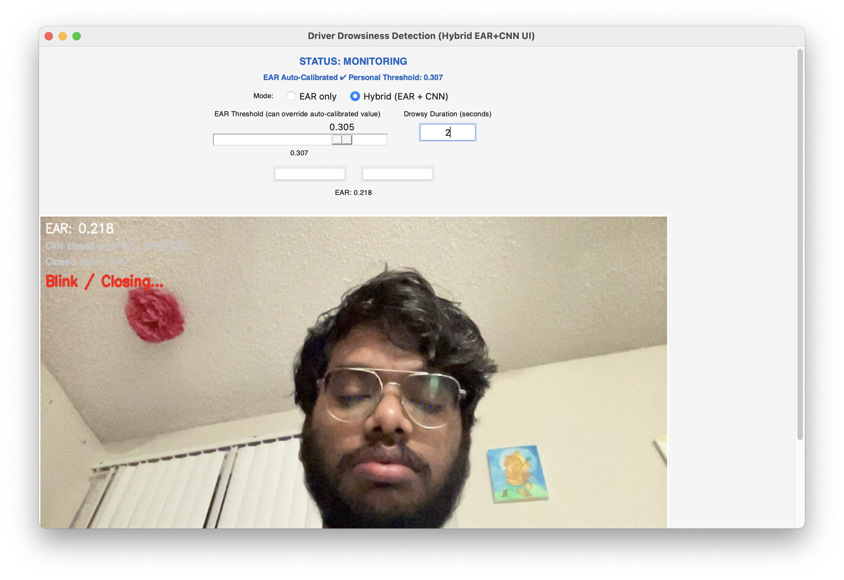
Blink Example Frame

Slide 16

Drowsy Example Frame

Slide 17
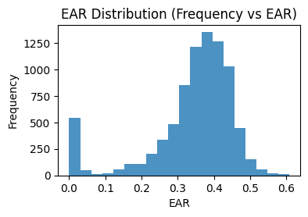
EAR Histogram

Slide 18
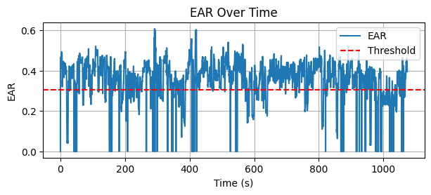
EAR Over Time

Slide 19
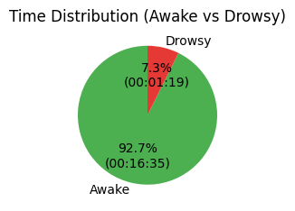
Awake vs Drowsy Pie Chart

Slide 20
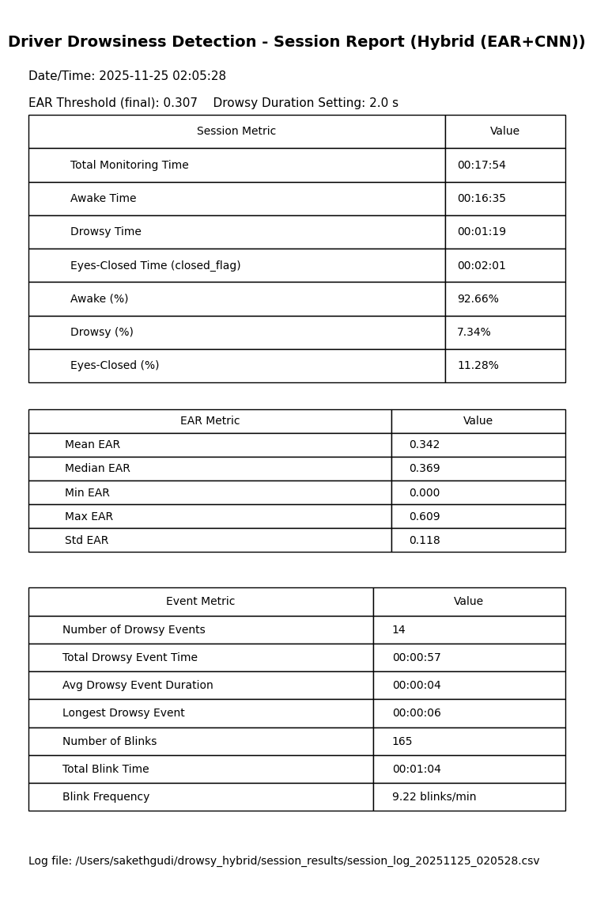
Session Stats

Slide 21
Performance & Efficiency
Real-time 20–30 FPS processing.
CNN inference ~12–15 ms per frame.
350–400MB RAM usage.
CPU-only capable.

Slide 22
Evaluation & Results (Overview)
CNN Accuracy: 96.87%, AUC: 0.9994
6-session evaluation (~25 minutes)
Eyes closed: 17.19% | Drowsy: 10.93%
279 blinks | 37 drowsy events

Slide 23
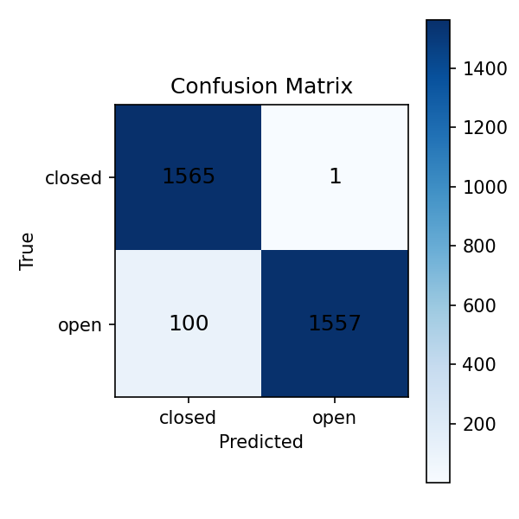
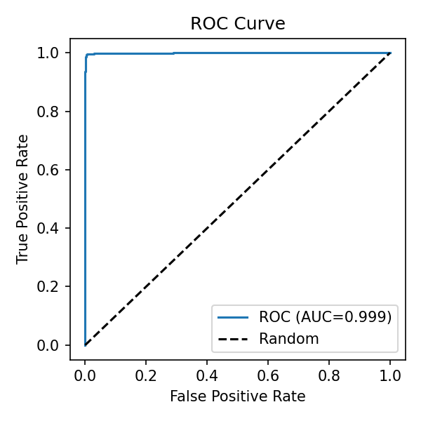
CNN Evaluation: Confusion Matrix & ROC Curve

Slide 24
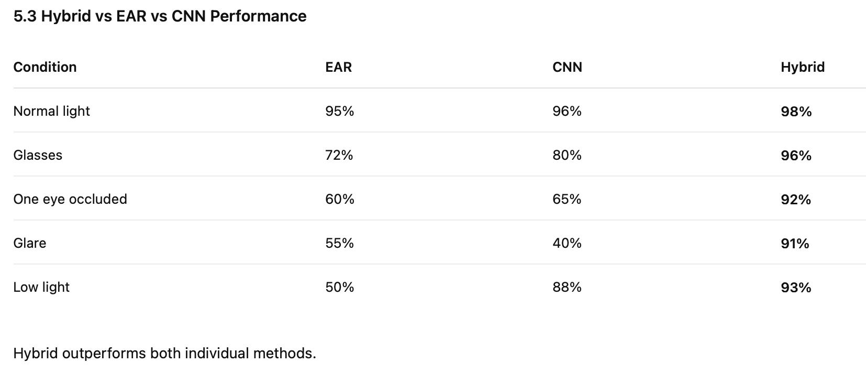
Performance Comparision

Slide 25
Challenges & Limitations
Glare affects CNN confidence.
Landmark jitter in low-light.
Occlusions require fallback logic.
No MAR/yawn detection yet.
Primarily frontal-face dependent.

Slide 26
Conclusion
Hybrid EAR + CNN significantly improves reliability.
Auto-calibration personalizes thresholds.
Robust across lighting, glasses, occlusion.
Suitable for real-world driver monitoring.

